Slide 1


NEXT GEN EMPLOYABILITY PROGRAM
CREATING A FUTURE-READY WORKFORCE
Student Name :
Pranit Tukaram Akhade
Student ID :
STU5f523ed9daf501599225561
Mobile No:
9284017640
Mail ID:
pranitakhade65@gmail.com
College Name :
Sinhgad College of Engineering, Vadgaon BK

Slide 2
CAPSTONE PROJECT SHOWCASE
Project Title
Health Care Data Driven Decision Using Power BI
Abstract | Problem Statement | Project Overview | Proposed Solution | Technology Used | Modelling & Results | Conclusion | Q&A

Slide 3
Abstract
1
Project utilizes Power BI to analyze healthcare data for informed decision-making.
2
By visualizing key metrics such as disease prevalence by habits, patient demographics, and average duration of hospital stays, our dashboard offers actionable insights.
3
Through interactive slicers, users can filter data based on rural/urban settings, gender, and type of admission.
4
This project aims to empower healthcare professionals with valuable insights derived from comprehensive data analysis.

Slide 4


Problem Statement
The lack of a comprehensive analytics solution for healthcare data inhibits informed decision-making and hampers the optimization of patient care strategies.
Manual data analysis processes are time-consuming and prone to errors, leading to inefficiencies in identifying healthcare trends and addressing patient needs effectively.
There is a critical need for an intuitive and interactive analytics platform that can integrate and analyze diverse healthcare datasets to provide actionable insights for healthcare professionals.
This project aims to address these challenges by developing a Power BI-based healthcare analytics dashboard that enables efficient visualization and analysis of patient demographics, medical conditions, and treatment outcomes.

Slide 5

Project Overview
Develop an interactive healthcare analytics dashboard using Power BI.
Integrate diverse healthcare datasets including patient demographics, medical records, and treatment outcomes.
Provide interactive visualization and analysis features for exploring healthcare data.
Calculate key metrics such as disease prevalence, patient demographics by age group, and average duration of stay.
Enable professionals to make informed decisions based on actionable insights derived from the dashboard.
Monitor dashboard performance and usability for iterative enhancements.
Incorporate feedback to optimize dashboard effectiveness in supporting decision-making.
Enhance data-driven decision-making in healthcare settings, ultimately improving patient care outcomes.

Slide 6
Proposed Solution
Implementation of a Power BI-based healthcare analytics dashboard to facilitate data visualization and analysis.
Integration of diverse healthcare datasets, including patient demographics, medical conditions, and treatment outcomes, into the dashboard.
Development of interactive visualizations to highlight disease prevalence based on patient habits (e.g., smoking, alcohol consumption) and other relevant factors.
Incorporation of key metrics such as average duration of stay in hospital and ICU to provide actionable insights into patient care strategies.
Implementation of user-friendly features and intuitive navigation to enhance accessibility and usability for professionals.
Regular updates and maintenance of the dashboard to ensure accuracy and relevance of the data presented.
Collaboration with healthcare professionals and stakeholders to gather feedback and continuously improve the dashboard's functionalities and effectiveness in supporting data-driven decision-making processes.

Slide 7
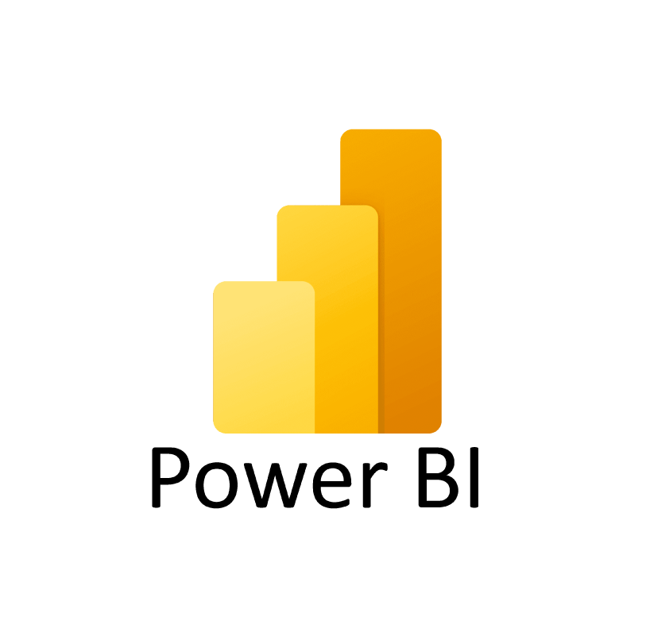
Technology used
Power BI

Slide 8
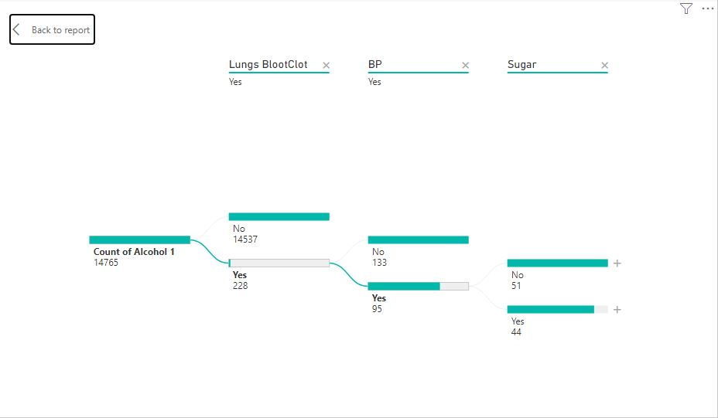
Modelling & Result

Slide 9
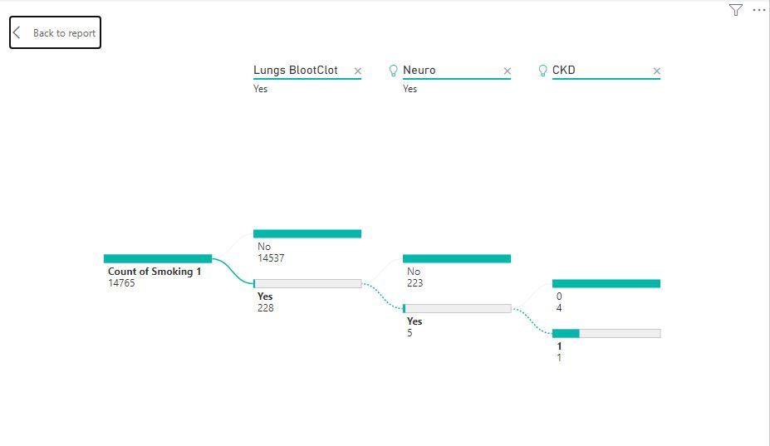
Modelling & Result

Slide 10
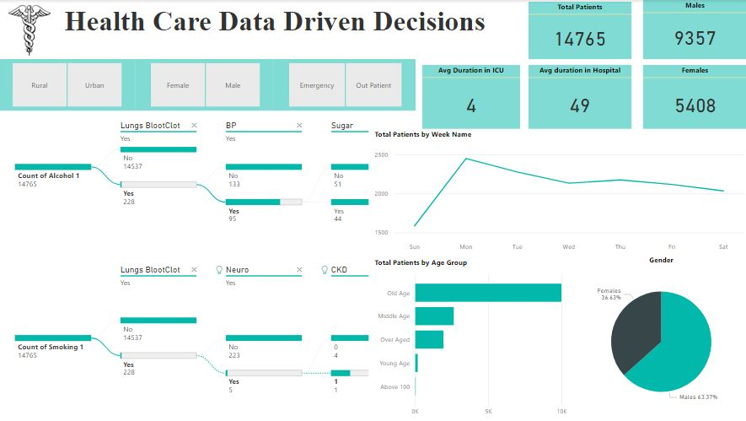
Modelling & Result

Slide 11

Conclusion
The developed Power BI healthcare analytics dashboard enhances data-driven decision-making in healthcare.
Health Care Professionals are empowered to gain actionable insights into patient demographics and treatment outcomes.
Collaboration with healthcare professionals ensures ongoing refinement and optimization of the dashboard.
The project has successfully addressed the challenges associated with manual data analysis, providing a user-friendly platform for exploring and understanding complex healthcare datasets.
Continuous monitoring and evaluation facilitate the dashboard's effectiveness in improving patient care outcomes.

Slide 12


Notes:
Thank You !!

